Slide 1
Lecture No. 2 Electrochemistry
At the end of this lecture, students will be able to:
Explain thermodynamic relation of free energy and potential
Derive Nernst equation for single electrode potential
Illustrate the construction of an electrochemical cell

Slide 2
Electrochemistry
Thermodynamic Relation: Nernst Equation
Single electrode potential can be expressed in the form of Nernst equation
Nernst equation is a thermodynamic equation, which relates the change in free energy (∆G) and cell potential (E) with concentration (M^{n+})

Slide 3
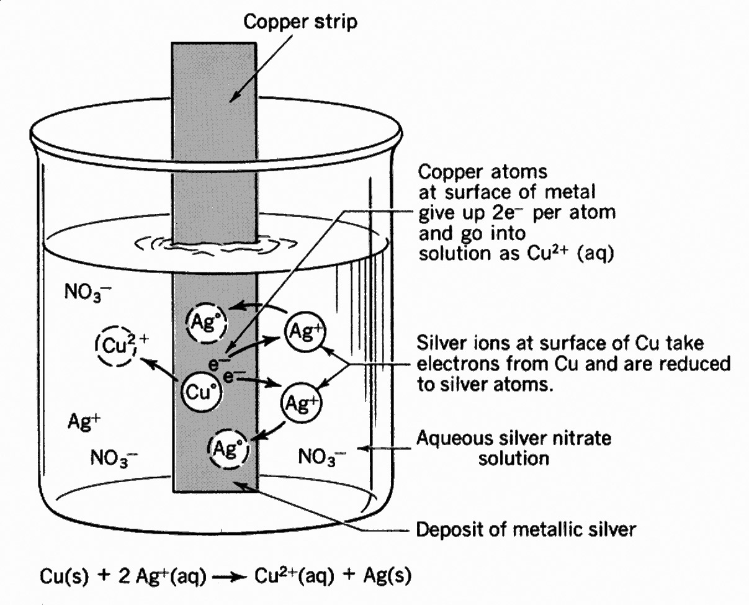
Nernst Equation
Consider a reversible redox reaction
of the electrode, M^{n+} + ne  M
Reaction constant K is related to the free energy by Vant- Hoff’s isotherm as,
∆G = ∆G º + RT ln K where K is reaction constant = (1)

Slide 4
Nernst Equation
Maximum work derived from this reaction is equal to the decrease in the free energy change
W_{max} = - ∆G (2)
Considering the work done as electrical energy,
W_{max} = Electrical energy
= No. of coulombs x Energy available per coulomb
= nF x E (3)
∆G = -nEF (from equations 2 and 3)
∆Gº = -nEºF

Slide 5
Nernst Equation
Where, ∆Gº is the standard free energy change and Eº is the standard electrode potential
Substituting the values for ∆G, ∆Gº and K in equation (1),
(4)
Dividing equation (4) by – nF,
(5)

Slide 6
Nernst Equation
and ( [M] =1 )
(6)
where, R is called gas constant = 8.314 JK⁻¹mol⁻¹ , T is standard temperature = 298 K, F is the Faraday constant = 96,500 Coulomb mol⁻¹ and n is the number of electrons.
Substituting the above constants converting the natural log into log₁₀ in equation (7), we get,

Slide 7
Nernst Equation
For the following reversible reaction,
aA + bB  cC + dD
Nernst equation for cell potential is given by
at 25°C
Where R= 8.314 JK⁻¹mol⁻¹ , T=298K, F=96485.3 C mol⁻¹, n- number of electrons

Slide 8
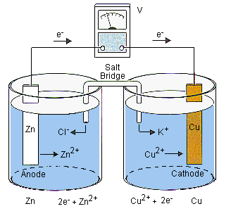
Electrode Potential and Cells
How cells are made?
Cells are made up of two electrodes, one being Anode (negative electrode) and the other being Cathode (positive electrode)
Ex: Cu²⁺/Zn²⁺

Slide 9
Electrode Potential and Cells
Cell Representations, Notations and Conventions:
Representation of Daniel Cell : Coupling Zn half cell and Cu half cell through a salt bridge
Zn (s) / Zn²⁺(1M) // Cu²⁺(1M) / Cu (s)
Notations:
Single vertical line indicates the phase boundary between the metal and the solution of its own ions
Double vertical lines represent the salt bridge
Direction of the arrow indicates the direction of flow of the electrons in the external circuit

Slide 10
Electrode Potential and Cells
Conventions
Electrode where oxidation takes place is called anode (negative electrode) and is written on the left side of the salt bridge
Electrode where reduction takes place is called cathode (positive electrode) and is written on the right side of the salt bridge
Anode is written as metal first and then electrolyte
Anode half cell is written as Zn / Zn²⁺ (1M)
Cathode is written as electrolyte first and then metal. The cathode half cell is written as Cu²⁺ (1M) / Cu

Slide 11
Electrode Potential and Cells
Cell reaction is spontaneous then emf of the cell has positive sign or if electrons move from left to right in an external circuit then emf of a cell has positive sign
. If the cell reaction is non-spontaneous then emf of the cell has negative sign or if electrons move from right to left in an external circuit then emf of a cell has negative sign
Electrode potential is always referred to as reduction potential and is represented as E_{M}^{n+}_{/M} and oxidation potential is represented as E _{M} /_{M}^{n+}
E_{cell} can be calculated using
E_{cell} = E_{cathode} - E_{anode}

Slide 12
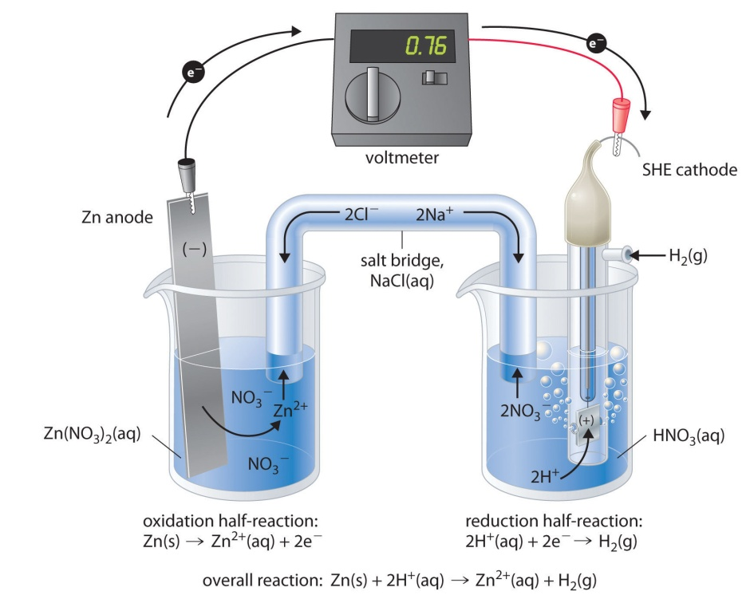
Electrode Potential and Cells
How electrode potentials are measured?
Electrode potentials are measured by combining the electrode with a reference electrode such as standard hydrogen electrode, calomel or Ag-AgCl electrode
Ex: Zn²⁺/SHE
E_{cell} = - 0.76V

Slide 13
Electrode Potential and Cells
RHS is the standard hydrogen electrode, and
LHS is the electrode the potential of which is being defined
By convention: E_{Cell} = E_{Cathode} − E_{Anode}
For the cell with the standard hydrogen electrode (potential of 0 by convention)
E_{Cell} = E_{Right} − E_{left} = E_{SHE –} E_{Zn2+}= 0- 0.76 = -0.76V

Slide 14
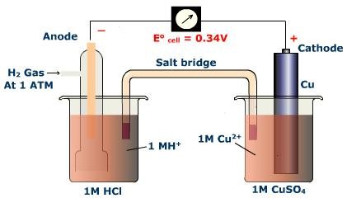
Electrode Potential and Cells
Reference electrodes can act both as anode and cathode depending on the other electrode coupled
E_{Cell} = E_{Right} − E_{left} = E_{Cu2+} − E_{SHE}= 0.34 - 0 = 0.34V

Slide 15
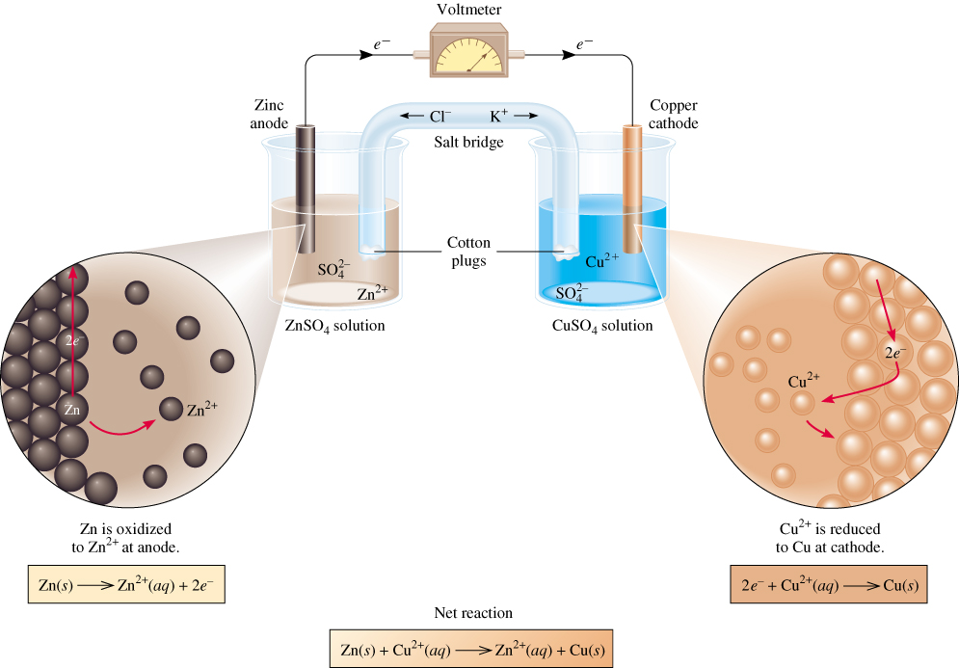
Electrode Potential and Cells
Galvanic Cell:
Representation: Zn/Zn²⁺//Cu²⁺/Cu
anode
oxidation
cathode
reduction
spontaneous
redox reaction

Slide 16
Electrode Potential and Cells
Liquid Junction Potential: Difference between the electric potentials developed in the two solutions across their interface
E_{j} = Ø _{soln, R} - Ø _{soln,L}
Contact between two different electrolytes (ZnSO₄/ CuSO₄)
Contact between same electrolyte of different concentrations (0.1M HCl /1.0 M HCl)
Liquid junction potential can be reduced by joining the electrolyte compartments through a salt bridge

Slide 17
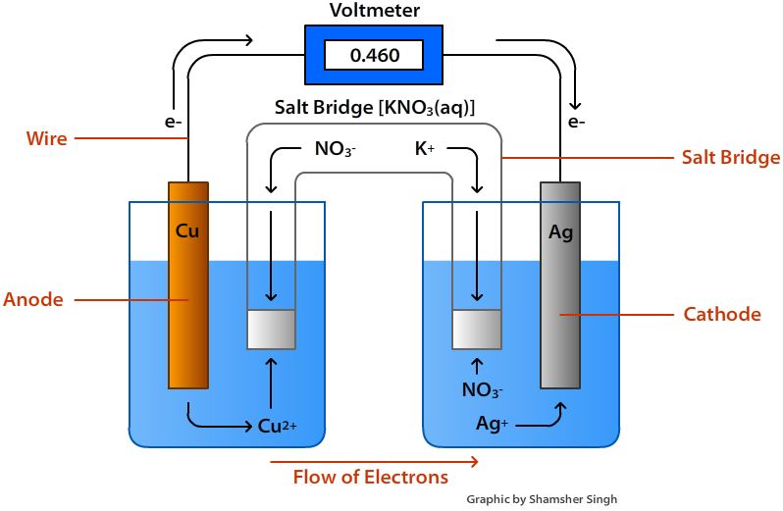
Electrode Potential and Cells
Role of salt bridge?
Provides electrolytic contact between the two electrolyte solutions of a cell
Avoids or at least reduces (to about 1 to 2 mV) junction potential in galvanic cells containing two electrolyte solutions in contact
How a cell works?

Slide 18
Electrode Potential and Cells
Definition of Electro Motive Force [EMF]: Difference of potential, which causes a current to flow from the electrode of higher potential to one of lower potential
EMF is denoted by E and measured in volts or energy supplied per unit charge is called EMF
E_{cell} = E_{cathode}- E_{anode}
E _{Cell} depends on:
Nature of the electrodes
Temperature
Concentration of the electrolyte solutions

Slide 19
Summary
Thermodynamic relation of free energy and potential - Nernst equation
Construction of cells: Anode, cathode, salt bridge
Representation of a cell
Notations, signs and conventions for cells
Eg: Zn | ZnSO4 (1M) || CuSO4 (1M) | Cu

